Slide 1
REST API & Functional Programming

Slide 2
Contents
REST
Quick review
Client side
Server side
Functional Programming

Slide 3
REST Review
Is REST and HTTP same thing?
Key components of REST?
What request we want to do?
Where is the resources?

Slide 4
REST Review
Is REST and HTTP same thing?
REST is a specific style of using HTTP
REST is the way HTTP should be used
Key components of REST?
What to do?
HTTP methods: GET, PUT, POST, DELETE, etc.
Where are the resources?
URL: domain, version, collections, objects

Slide 5
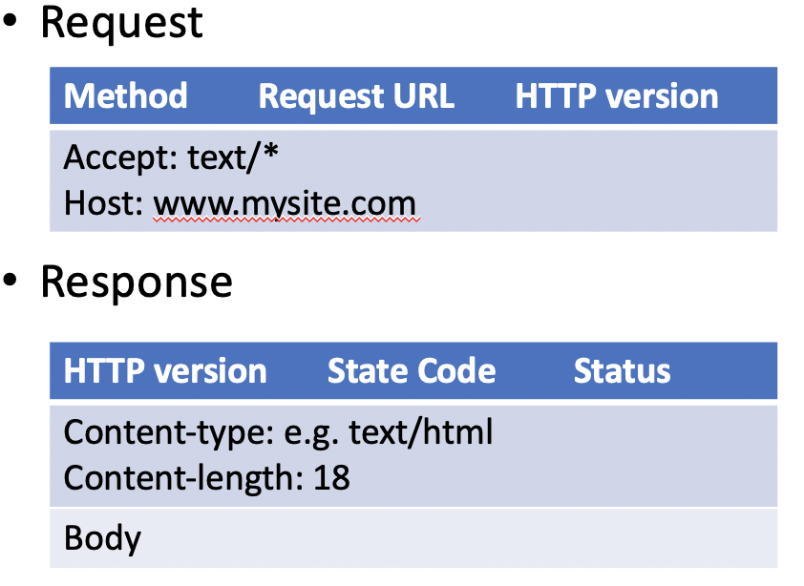
Client Side
Sending Request & Waiting response
AJAX
Dynamically update content from remote source
Make a new request to a server
Process the response

Slide 6
Client Side
XMLHttpRequest
Get a new XMLHttpRequest object
var xhr = new XMLHttpRequest();
Open with specific parameters
xhr.open("GET", "data.txt", true);
Parameters: HTTP Methods, URL, Asynchronous switch
Send a request
send();
send(“param1=x&m2=y");
When complete, handle the response

Slide 7
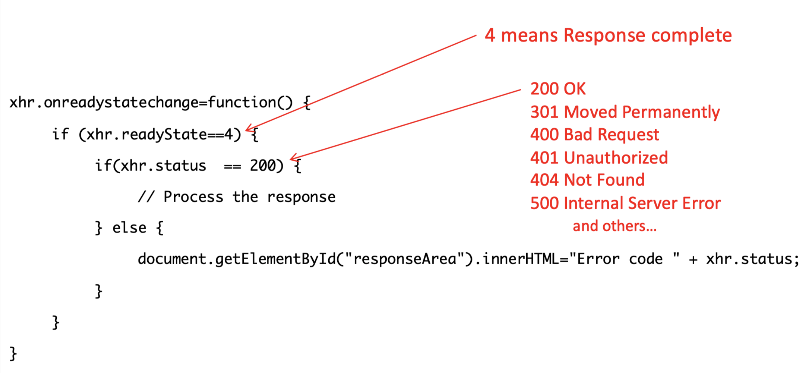
Client Side
Example of response handling function

Slide 8
Server side
Parse and return values as response on demand
Flask-RESTful API
A flask library gives functionality to arrange routes and resources

Slide 9
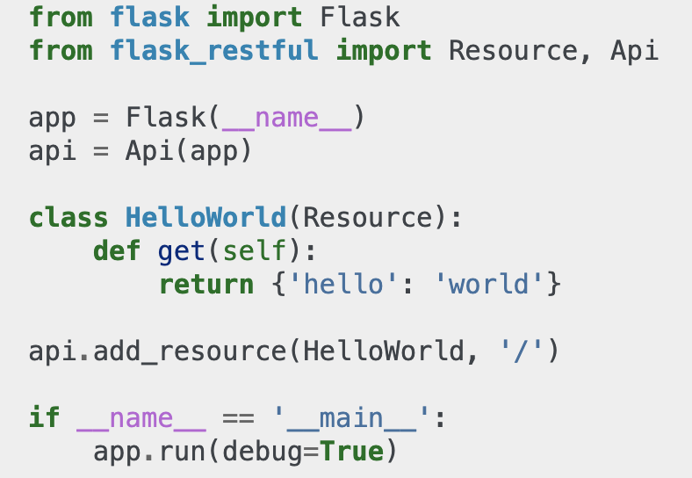
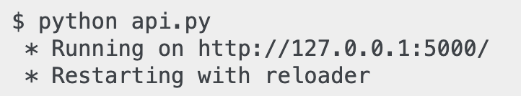

Minimal API

Slide 10
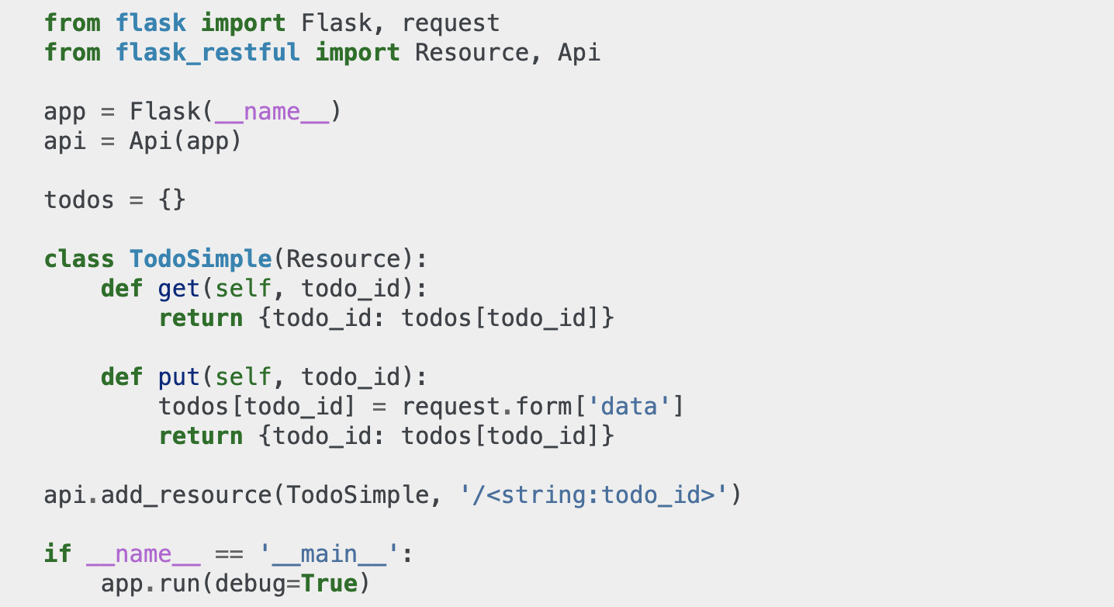
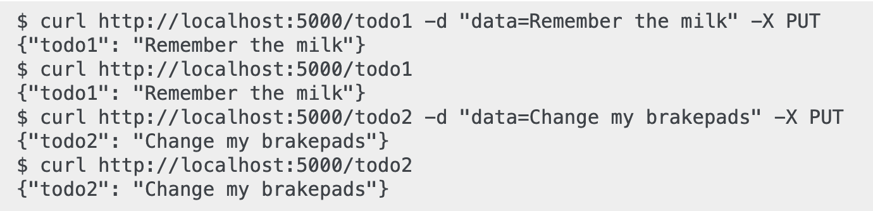
Resourseful Routing

Slide 11
More info
Documentation
https://flask-restful.readthedocs.io/en/0.3.5/index.html

Slide 12
Functional Programming
Map
Filter
Reduce

